Slide 1
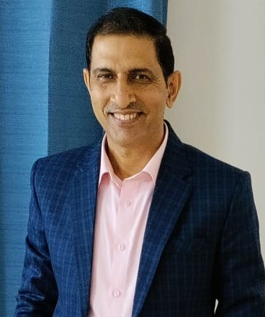
Proposal to conduct a Female Safety Training Session by
PEHAL At A Drop In Ocean(Foundation)
Training Scope:
Safety Awareness for Women: Identifying and responding to risks in everyday environments
Self-Defence Techniques: Simple, practical methods to handle and exit unsafe situations
Duration : 1 Hour Mode: Interactive Date :TBD – Location – Sobha City Club
Training Instructor:Mr. Takdir Singh
Ex-Police Officer with 38+ years in safety, security & legal domains
Served Prime Ministers of India (SPG, 10+ years)
Expert in unarmed combat, martial arts & Krav Maga
Link of PEHAL(FOUNDATION) - https://pehalindiafoundation.com/
Email ID - info@pehalindiafoundation.com / takdirsingh64@gmail.com, Mobile - 9319744332

